Slide 1
Project Reporting
Microsoft Project 2016
Lesson 10

Slide 2
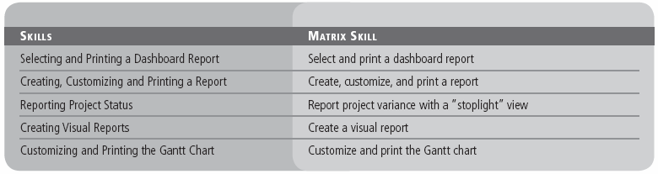
Objectives

Slide 3
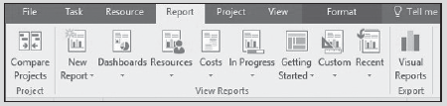
Software Orientation
The Report ribbon, shown below, makes locating and selecting a report in Microsoft Project easier than ever before.
With predefined dashboard reports, the user can show an overview of the project, project burndown, cost overview, work overview, and many more reports.
Notes:
Report ribbon

Slide 4
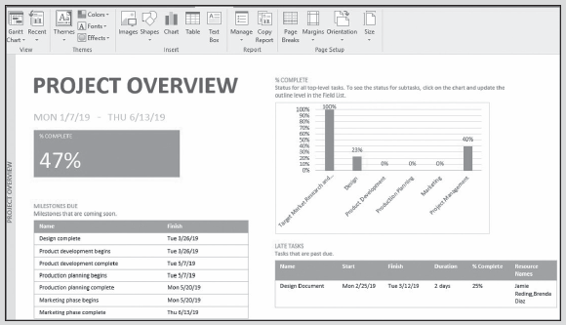
Software Orientation
The Project Overview dashboard, shown below, provides the basic information needed to present project performance to date, which tasks are late, which milestones are coming due, and an overall percent complete.
Notes:
Project Overview dashboard report with the Report tools ribbon

Slide 5
Selecting and Printing a Dashboard Report
Using a dashboard report, you can quickly see all of the major information about your project and then print the information on paper.
In the following exercise, you will view and print a dashboard report for your project. A report is anything the project manager uses to transmit information about the project.
Most reports are done in writing, using both words and graphics. Some reports are made available through dashboards. A dashboard is an easy‐to-read, single‐page interface that senior management can quickly view to obtain a high‐level view of current project status.

Slide 6
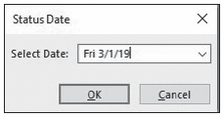
Step-by-Step: Select and Print a Dashboard Report
GET READY. Before you begin these steps, open Tailspin Remote Drone 10M from the data files for this lesson. Save the file as Tailspin Remote Drone 10 in the solutions folder.
On the ribbon, click the Project tab. In the Status group, in the Status Date field, click once on the calendar icon. Microsoft Project displays the Status Date dialog box.
In the Select Date: field, key or select 3/1/19. Your screen should look similar to the figure below.
Notes:
Status Date dialog box

Slide 7
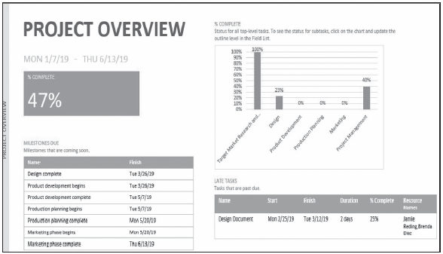
Step-by-Step: Select and Print a Dashboard Report
Click OK to close the Status Date dialog box. You set the status date to tell Microsoft Project you want information as of this date.
On the ribbon, click the Report tab and then click the Dashboards button. From the drop‐down menu that appears, select Project Overview. Your screen should look similar to the figure below.
Notes:
Project Overview dashboard

Slide 8
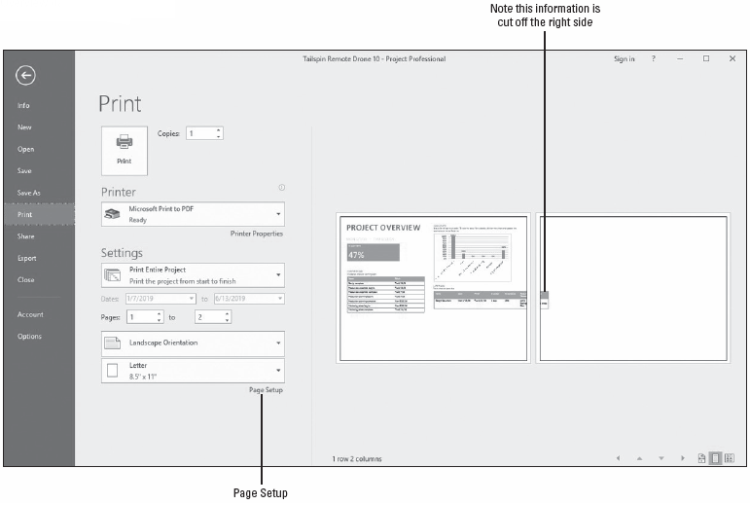
Step-by-Step: Select and Print a Dashboard Report
On the ribbon, click the File tab and then click Print. Your screen should look like the figure below. You might notice that some of the report is cut off on the right side of the Print Preview area.
Notes:
Print Preview of the Project Overview dashboard

Slide 9
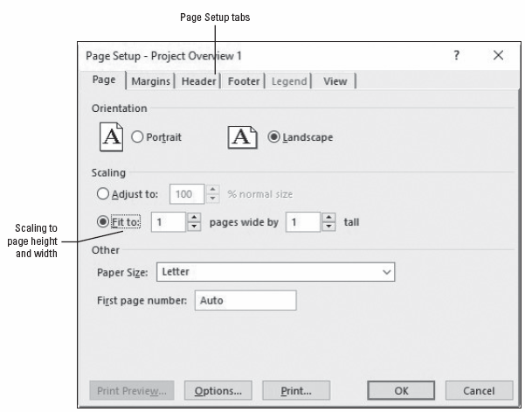
Step-by-Step: Select and Print a Dashboard Report
At the lower‐right portion of the Settings section, click the Page Setup hyperlink. Project displays the Page Setup dialog box.
On the Page tab, in the Scaling section, select the Fit to: option and then select 1 page wide by 1 page tall. Your dialog box should look similar to the figure at right.
Notes:
Take Note: You might or might not see the Print Preview screens in color, depending upon the printer and print drivers you have installed.

Slide 10
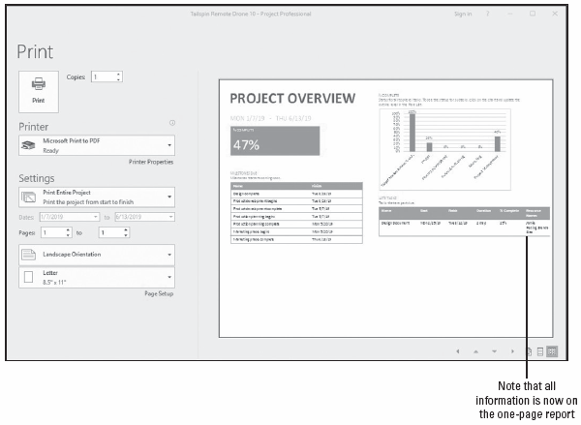
Step-by-Step: Select and Print a Dashboard Report
Click OK. Your screen should now look similar to the figure at right.
Click the return arrow in the upper‐left corner of the Print window.
SAVE the project schedule.
PAUSE. LEAVE Project open to use in the next exercise.
Notes:
Print Preview of the Project Overview dashboard with new settings

Slide 11
Customizing and Printing a Report
Using the new options of the Reports feature in Microsoft Project 2016 allows you to fully customize the information you want to include in the report.
In the following exercise, you will create a custom report and add information that you want to include.
Printing information from a project schedule to share with stakeholders is a common activity for project managers.
Stakeholders are the people or organizations that might be affected by project activities and can range from resources working on the project to customers receiving the project deliverables.

Slide 12
Step-by-Step: Create, Customize, and Print a Report
GET READY. USE the project schedule you created in the previous exercise.
Click the Report tab. On the ribbon, click the New Report button.
In the drop‐down menu that appears, click Table.
In the Report Name box that appears, name the new report Remaining Work Report and then click OK. Your screen should look similar to the figure on the next slide.
At the top of the Field List at the right of the screen, click Resources.
Using the scroll box at the right of the Field List box, navigate down until the Work fields are visible and then select the expand button next to Work.
Select the Remaining Work check box.

Slide 13
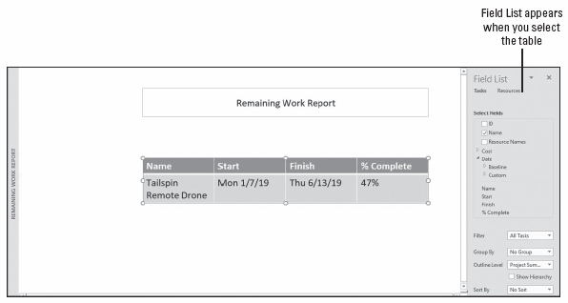
Step-by-Step: Create, Customize, and Print a Report
Notes:
Newly created Remaining Work Report

Slide 14
Step-by-Step: Create, Customize, and Print a Report
In the Filter box, select Resources ‐ Work.
In the Sort by box, select Name.
Auto‐fit the name and Remaining Work columns (make them wider so all information fits on one line) and then manually center the entire table on the screen under the report name.
Click the File tab and then click Print. You will note that the report might not be centered on the page. This is because the previous report was set for Landscape orientation.
In the Settings section, change the orientation to Portrait.
Click the return arrow in the upper‐left area of the Print dialog box.
Click the minus sign on the Zoom slider two or three times. Move the table and the Report Name box to the left of the page (screen). Your screen should look like the figure on the next slide.
Notes:
Take Note: At this point, you can print the information by clicking the Print button (the Print Preview is adequate for the purposes of this lesson). When printing in Microsoft Project 2016, there are additional options in the Print dialog box (the Print command is accessed from the File tab). For example, you can print specific date or page ranges.

Slide 15
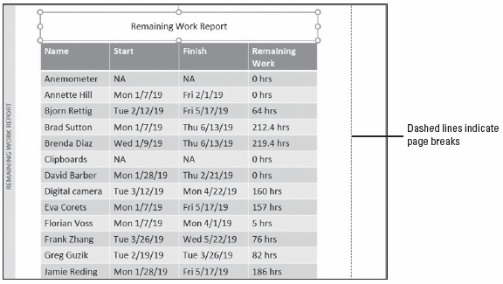
Step-by-Step: Create, Customize, and Print a Report
Click the File tab and click Print. The report is now centered on the page.
Click the return arrow at the upper‐left portion of the Print dialog box.
SAVE the project schedule.
PAUSE. LEAVE Project open to use in the next exercise.
Notes:
Report view with Remaining Work Report centered on the first page

Slide 16
Reporting Project Status
Microsoft Project provides many different ways to report a project’s status in terms of budget or variance. A key part of a project manager’s job is knowing which stakeholders need to see which details in which format.
In the following exercise, you will use a custom field with a custom formula to create a custom stoplight report.
A stoplight report is a visual way, using “stoplight” colors of green, yellow, and red, as a method of quickly showing how each task is doing.
As a project manager, you will find many ways to present the current status of your project. Bear in mind the audience of the report. For example, you will want to present high‐level information to upper management. Conversely, you will want to give detailed information to the project team.

Slide 17
Step-by-Step: Report Project Variance with a “Stoplight” View
GET READY. USE the project schedule you created in the previous exercise.
Click the View tab. In the Task views group, click Other Views and then select More Views. In the list, select Task Sheet and then click Apply. Microsoft Project displays the Task Sheet view.
Click the Tables button and then click Cost.
Click the Project tab and then click the Custom Fields button. The Custom Fields dialog box appears.
Under the Field label at the top of the dialog box, make sure that Task is selected. In the Type box, select Number from the drop‐down list.
In the Field list, select Overbudget (Number3).

Slide 18
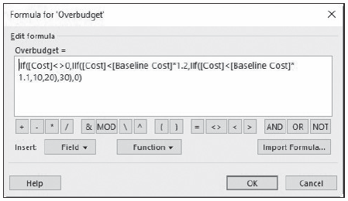
Step-by-Step: Report Project Variance with a “Stoplight” View
Under the Custom attributes label, click the Formula button. The formula shown in this dialog box has been pre‐entered for accuracy and to save time. Your screen should look the figure below.
Notes:
The formula evaluates each task’s cost variance. If the task is 20 percent above baseline, the formula assigns the number 30 to the task; if it is between 20 percent and 10 percent, a 20; and if below 10 percent, a 10. If the task does not fit within those criteria, such as the case with a milestone task that should have no costs, the formula returns a zero value.

Slide 19
Step-by-Step: Report Project Variance with a “Stoplight” View
Click Cancel to close the Formula dialog box.
In the Custom Fields dialog box, under the Values to display label, click the Graphical Indicators button. The Graphical Indicators dialog box enables you to specify a unique graphical indicator to display, depending on the value of a field for each task.
Click the first cell under the Image column heading, and then click the drop‐down arrow.
Click Cancel twice to close the Graphical Indicators dialog box, and then click Cancel again to close the Custom Fields dialog box.
Right‐click on the Fixed Cost column heading. Select Insert Column from the list.
From the keyboard, start typing the word Over. Notice how Project narrows the list down as you type.
Notes:
Take Note: For the purposes of this project, a variance of 20 percent above baseline has been decided on by the project manager and sponsor as the maximum tolerance level.

Slide 20
Step-by-Step: Report Project Variance with a “Stoplight” View
Select Overbudget (Number3) from the list. Microsoft Project displays the Overbudget column in the Cost table. Your screen should look similar to the figure on the next slide.
The custom field Overbudget (Number3) displays a graphical indicator that represents one of three different levels of cost variance. The graphical indicators will change, according to the ranges specified in the formula, as each task’s cost variance changes. This is a useful format for identifying tasks whose cost variance is higher than you would like (as indicated by the red and yellow indicators). This makes it easy for any stakeholder to quickly scan the task list and locate tasks that need further attention.
SAVE the project schedule.
PAUSE. LEAVE Project open to use in the next exercise.
Notes:
More Info: You will learn more about saving Microsoft Project data in other formats in Lesson 12.

Slide 21
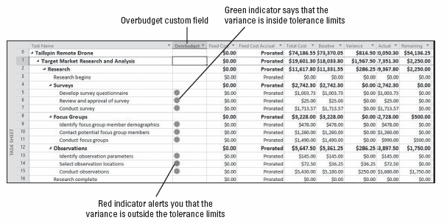
Step-by-Step: Report Project Variance with a “Stoplight” View
Notes:
Cost table with the Overbudget custom field displayed

Slide 22
Using Visual Reports
The Visual Reports feature of Microsoft Project 2016 combines the power of Microsoft Excel and Microsoft Visio with the data of your project to create high‐impact, visually centered reports.
You can use a preformatted report, edit a report, or create a new report that includes a specific set of fields from Microsoft Project.
In the following exercise, you will create a new visual report. A visual report is a specific type of report that combines the power of either Microsoft Excel or Microsoft Visio and the data that you have created in your project file. The data is translated into pivot tables and graphs.
You must have Microsoft Excel 2007 or newer to view the Excel reports with the Visual Reports feature. You must have Microsoft Visio 2007 Professional or higher installed on your system to view the Visio reports.

Slide 23
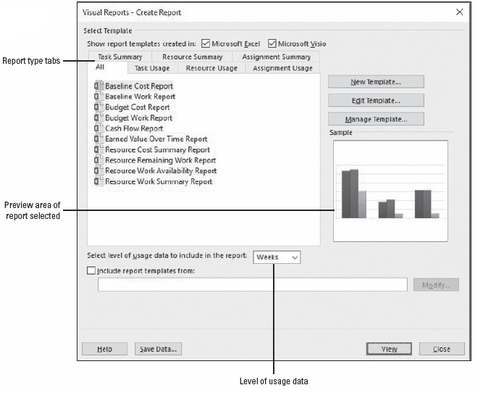
Step-by-Step: Create a Visual Report
GET READY. USE the project schedule you created in the previous exercise.
On the ribbon, click the Report tab and then click the Visual Reports button. The Visual Reports – Create Report dialog box appears. Your screen should look similar to the figure at right.
Notes:
Visual Reports dialog box

Slide 24
Step-by-Step: Create a Visual Report
Click the Task Usage tab and then click Cash Flow Report.
In the Select level of usage data to include in the report: box, select Months.
Click the View button. The Visual Report engine gathers data from your project file and builds an Online Analytical Processing (OLAP) cube. The application Microsoft Excel opens and the report is presented in Chart form from a preformatted report template. Your screen should look similar to the figure on the next slide.
At the bottom of the Excel window, select the Task Usage sheet tab.

Slide 25
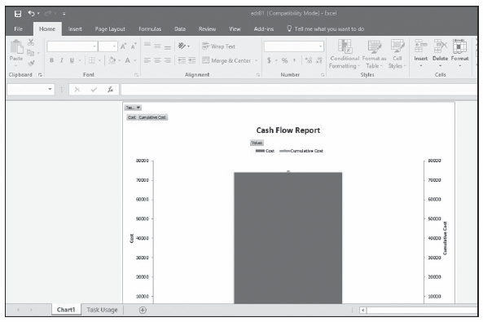
Step-by-Step: Create a Visual Report
Notes:
The visual report named “Cash Flow Report” in Microsoft Excel

Slide 26
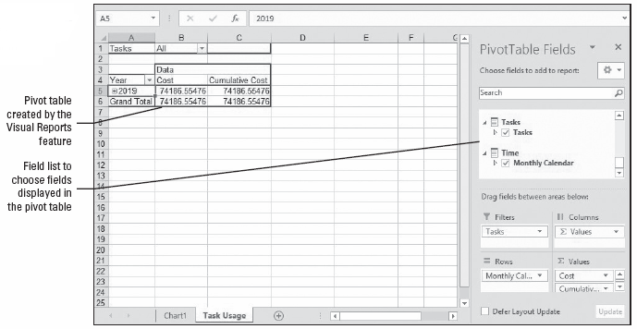
Step-by-Step: Create a Visual Report
In the PivotTable Field List box at the right, navigate to the Time field. Place your cursor on Monthly Calendar and drag it to the Rows box. Your screen should look similar to the figure below.
Notes:
Task Usage sheet tab with Monthly Calendar in the Rows area

Slide 27
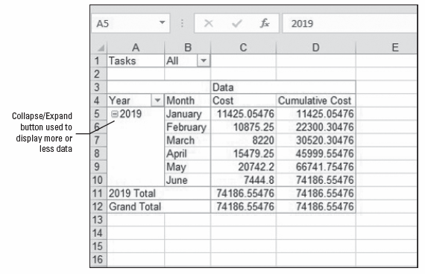
Step-by-Step: Create a Visual Report
In the PivotTable area on the left, click the expand button next to the year 2019, to reveal all the available time data. Your screen should look similar to the figure below.
Notes:
Cash Flow Report PivotTable with all of 2019 time data showing

Slide 28
Step-by-Step: Create a Visual Report
Click on the Chart1 sheet tab at the bottom of the screen. Your screen should look like the figure on the next slide.
Save the Microsoft Excel visual report as Remote Drone Cash Flow in your My Documents folder or another folder directed by your instructor.
CLOSE Microsoft Excel.
CLOSE the Visual Reports dialog box.
SAVE the project schedule.
PAUSE. LEAVE Project open to use in the next exercise.

Slide 29
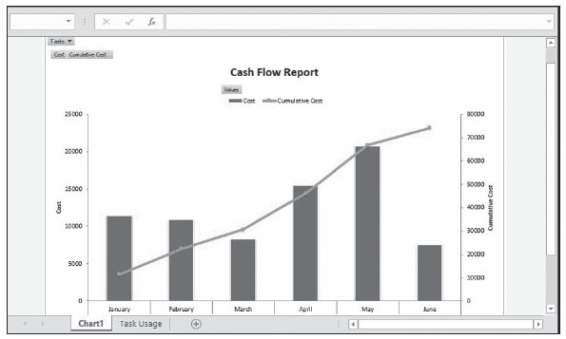
Step-by-Step: Create a Visual Report
Notes:
Cash Flow Report chart with the expanded time data

Slide 30
Customizing and Printing a View
Using a view, you can see your project schedule information on screen. You can change what you see by customizing the view. You can apply these customized views to print the information on paper.
In a view, you can enter, read, edit, and print information. In a report, you can only print the information—you cannot change the data. Printing a view allows you to provide, on paper, almost everything you see on your screen. You can print any view you see in Microsoft Project, with just a few exceptions:
You cannot print form views (e.g., Task Form) or certain diagrams, such as the Relationship Diagram.
If you have two views displayed in a combination view (one view in the top pane and the other view in the bottom pane), only the view in the active pane will print.
Notes:
In the following exercise, you will customize and print a Gantt Chart view. For a review of the types of views, including form views, refer to Lesson 8.

Slide 31
Step-by-Step: Customize and Print a Gantt Chart View
GET READY. USE the project schedule you created in the previous exercise.
Click the View tab and then click the Gantt Chart button.
Click the File tab and then click Print. Microsoft Project displays print options on the left side and the Gantt Chart view on the right side, which is the Print Preview window. Your screen should look similar to the figure on the next slide.
On the Print Preview toolbar, click the Page Right and/or Page Down button to display different pages.

Slide 32
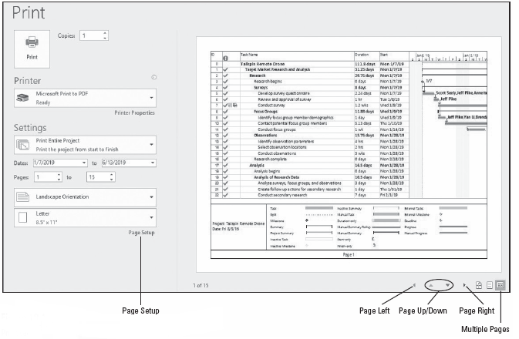
Step-by-Step: Customize and Print a Gantt Chart View
Notes:
Print section of the File tab

Slide 33
Step-by-Step: Customize and Print a Gantt Chart View
On the Print Preview toolbar, click the Multiple Pages button. Most of the pages of the Gantt chart appear in the Print Preview window. When the multiple pages Print Preview is active, the printed output is displayed on separate sheets. You navigate using the scroll control at the bottom of the Print Preview pane. The Page Right, Page Left, Page Up, and Page Down buttons are inactive. The paper size displayed is determined by your printer settings. Your screen should look like the figure on the next slide.
At the lower left of the Print Preview toolbar, the status bar should read “3 rows 5 columns.” In the Print Preview window, this means there are three rows of pages by five columns of pages, for a total of 15 pages. The status bar can help you quickly determine the total number of pages your printed view will be.

Slide 34
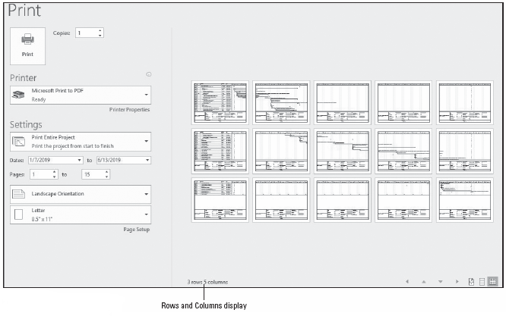
Step-by-Step: Customize and Print a Gantt Chart View
Notes:
Print Preview with Multiple Pages activated

Slide 35
Step-by-Step: Customize and Print a Gantt Chart View
On the Print Preview toolbar, click the One Page button. The first page of the Gantt chart is displayed.
Click the Page Setup hyperlink. The Page Setup dialog box appears.
Click the Header tab. You want to add the company name to the header that prints on each page.
There are three Alignment tabs in the center section of the Header tab. Select Center if it is not already selected. In the General box, select Company Name from the drop down menu options and then click the Add button next to the General box. Microsoft Project places the following code into the header: &[Company]. The software also displays a preview in the Preview window of the Page Setup dialog box.

Slide 36
Step-by-Step: Customize and Print a Gantt Chart View
Click the Legend tab. You want to change some of the content of the Gantt Chart view’s legend.
There are three Alignment tabs in the center of the Legend tab. Click the Left tab. Currently, Microsoft Project is formatted to print the project title and current date on the left side of the legend. You also want to print the start date and duration on the right side of the legend.
Click the Right Alignment tab. Click in the Right Alignment box, press Enter, and then key Start: followed by a space.
In the General box, select Project Start Date from the drop‐down list. Click the Add button next to the General box. Microsoft Project adds the label and code for the project start date to the legend.

Slide 37
Step-by-Step: Customize and Print a Gantt Chart View
Press Enter to add a second line to the legend and then key Duration: followed by a space.
In the Project Fields box, select Scheduled Duration from the drop‐down list. Click the Add button next to the Project Fields box. Microsoft Project adds the label and code for project duration to the legend.
In the Width box, key or use the scroll buttons to enter 3. This increases the width of the box that appears on the left side of the legend. Your screen should look similar to the figure on the next slide.
Click OK to close the Page Setup dialog box. Microsoft Project applies the custom changes to the legend.

Slide 38
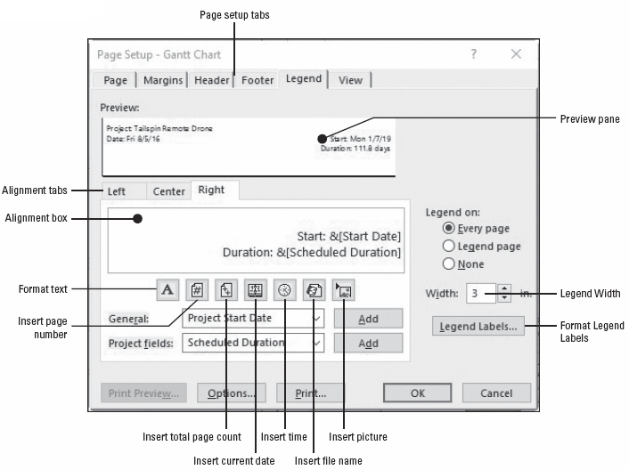
Step-by-Step: Customize and Print a Gantt Chart View
Notes:
Page Setup dialog box with custom selections for legend

Slide 39
Step-by-Step: Customize and Print a Gantt Chart View
Move your mouse cursor to the lower‐left corner of the page preview. Click on the lower‐left corner of the page. Microsoft Project zooms in to show the legend. Your screen should look similar to the figure on the next slide.
The data you added to the legend will print on every page of the printed output.
Click the return arrow at the upper‐left portion of the Print dialog box to return to the Gantt Chart view. Take note that although you did not print, your changes to the header and the legend will be saved when you save the project file.
SAVE the project schedule.
PAUSE. If you are continuing to the next lesson, keep Project open. If you are not continuing to additional lessons, CLOSE Project.
Notes:
Take Note: At this point, you can print the project schedule by clicking the Print button (the Print Preview is adequate for the purposes of this lesson). When printing in Microsoft Project 2016, there are additional options in the Print dialog box (the Print command is accessed from the File tab). For example, you can print specific date or page ranges.

Slide 40
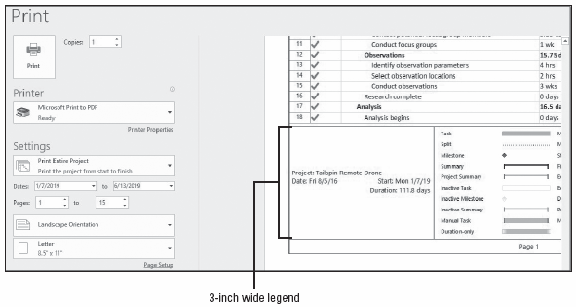
Step-by-Step: Customize and Print a Gantt Chart View
Notes:
Close‐up view of wider legend area

Slide 41
Customizing and Printing a View
In this lesson, you applied some custom formulas and graphical indicators to make it simple to review the status of tasks using the Task Sheet view.
Communicating the project status to stakeholders is one of the most important functions of a project manager and one that might occupy a significant portion of his working time.
It is imperative that the project manager know who needs to know the project status and why, as well as in what format and level of detail these people need the information.
The time to find the answers to these questions is in the initial planning stages of the project.

Slide 42
Customizing and Printing a View
Once work on the project has commenced, the project manager’s primary communication task will be reporting project status. This can take several forms:
Status reports that describe where the project is in terms of scope, cost, and schedule. These are often referred to as the triple constraint, which is a popular model of project management.
Progress reports that provide the specific accomplishments of the project team.
Forecasts that predict future project performance.

Slide 43
Customizing and Printing a View
Standard report formats might already exist if your organization is highly focused on projects and project management. If your organization does not have standard reports, you might be able to introduce project status formats that are based on clear communication and project management principles.
You might be able to report project status using some of the following:
Printing the Project Overview dashboard report.
Copying Microsoft Project data to other applications. For example, you could copy the Calendar view to Microsoft Office Word or Microsoft Office PowerPoint.
Saving Microsoft Project data in other formats, such as Excel, HTML, or GIF.

Slide 44
Customizing and Printing a View
It is important to keep in mind that the part of the project schedule you see on your screen is only a small part of the total project.
For example, to print a six‐month project with 75 tasks might require more than a dozen letter‐sized pages.
In general, Gantt charts and Network Diagrams can use significant amounts of paper on large projects.
Some experienced project managers who regularly use Microsoft Project print their projects on poster‐sized paper using plotters (a type of printer that draws pictures or graphs using attached pens) or other specialized printing equipment.

Slide 45
Customizing and Printing a View
Projects with several hundred tasks or long time frames will not print legibly on letter or legal-sized paper. To reduce the number of required pages, you can print just summary tasks or filtered data.
If you are interested in a specific time frame, you can print just that portion of the timescale, which is the band across the top of the Gantt chart grid that denotes units of time. A filter could be applied to display only the information that is of interest.
In any case, it is a good idea to preview the views you want to print. By using the Page Setup dialog box along with the Print Preview window, you can control many features of the view to be printed. For example, you can set the number of pages on which the view will be printed, apply headers and footers, and determine content that appears in the legend of the Gantt chart and some other views.
Notes:
Take Note: When printing in views that contain a timescale, such as the Gantt Chart view, you can change the number of pages required by adjusting the timescale before printing. To adjust the timescale so that it shows the largest time span in the smallest number of pages, click the View tab, then in the Zoom group, click Entire Project.

Slide 46
Skill Summary

